Slide 1
Challenge 2 Collecting, Saving, and Visualizing Data from the Physical World
Team members:
Shisheng wang
xiangtian yi
Ye xing
Yanlin zhou

Slide 2


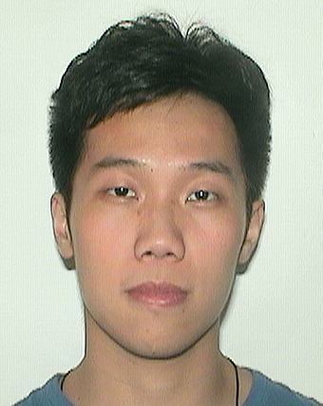

Presenter on this challenge
 | Xiangtian | Shisheng | Ye | Yanlin
Challenge 1 | Presenter
Challenge 2 |  | Presenter
Challenge 3 |  |  | Presenter
Challenge 4 |  |  |  | Presenter
Challenge 5 | Presenter
Challenge 6 |  | Presenter
Challenge 7 |  |  | Presenter
Challenge 8 |  |  |  | Presenter

Slide 3
TEAM WORK
Xiangtian | Shisheng | Ye | Yanlin

Slide 4



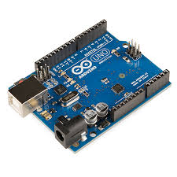
architecture
Request
Historical/Real-time data
Store data continuously
Send
Historical/Real-time data
Retrieves historical data

Slide 5

Design tools
Charting Library: ZingChart
Various charts online
Easy to apply
Support Real-time data
Data Storage: My SQL
Easy to use on Mac
Relational Database

Slide 6
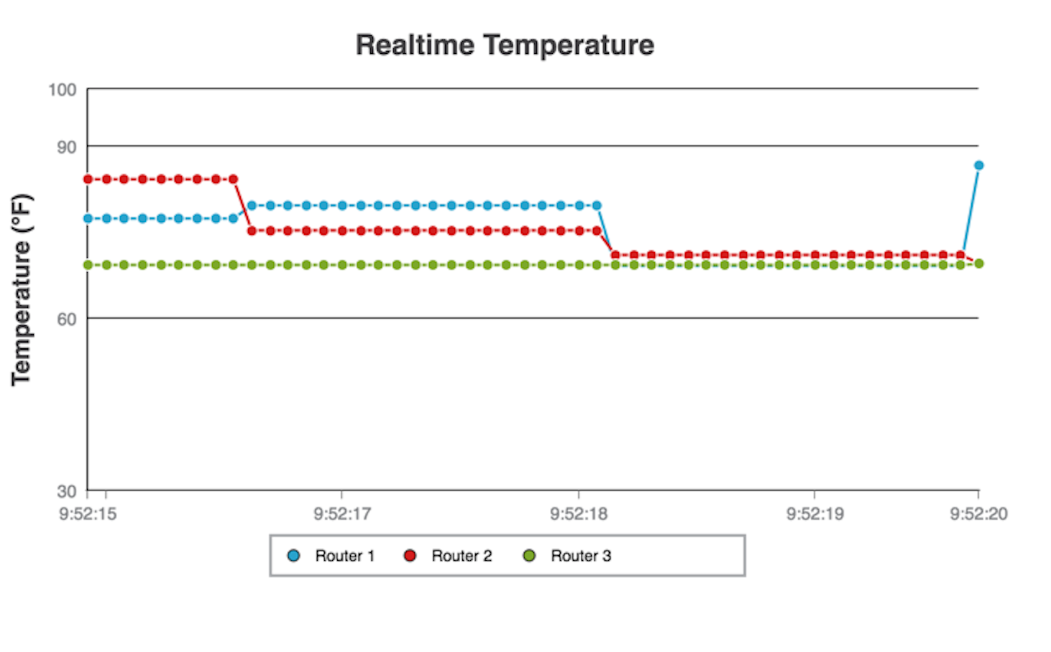
User Interface design
For the Real-time Temperature, we use a coordinate graph to show the temperature

Slide 7
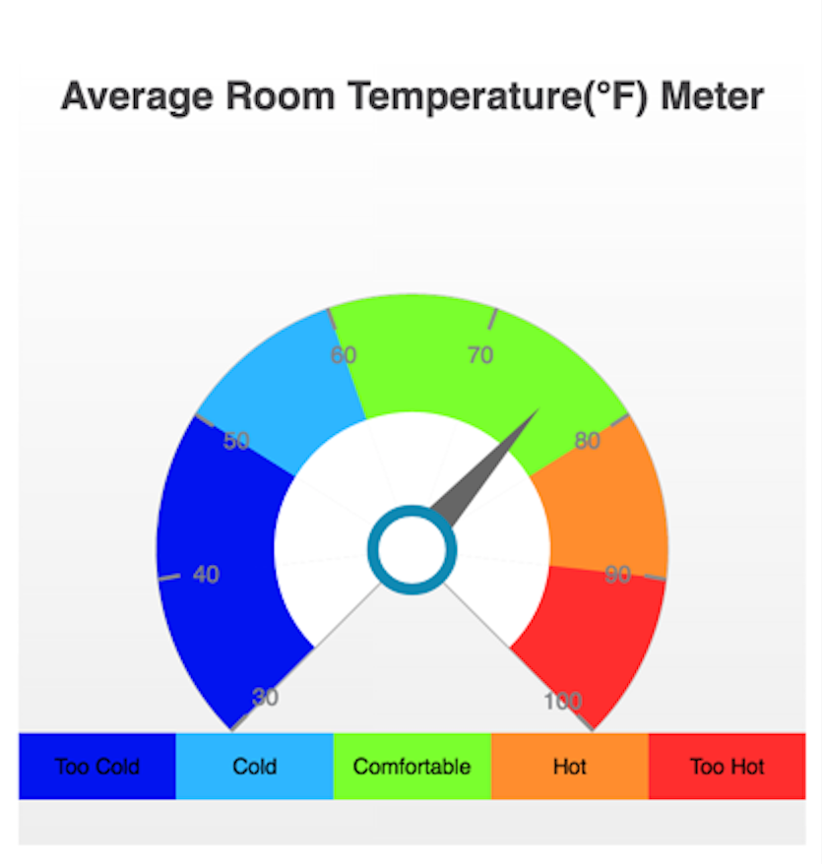
User Interface design
For the Average Temperature, we use a meter chart to show the temperature

Slide 8
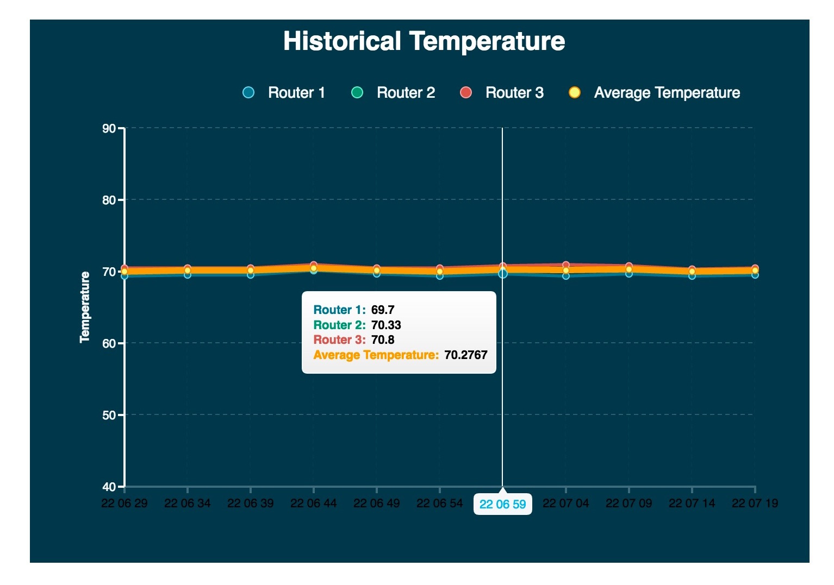
User Interface design
For the Historical temperature data, we choose to use the four lines to show the temperature data from different routers and the bolder line to show the historical average temperature data

Slide 9
Challenges
Learning to use the ZingChart API
Choosing a charting library which suits for the design architecture
Learning to integrate HTML, JavaScript, CSS, ZingChart, etc.
Learning to apply data from My SQL database on HTML
solve the circuit design issue in Challenge 1

Slide 10
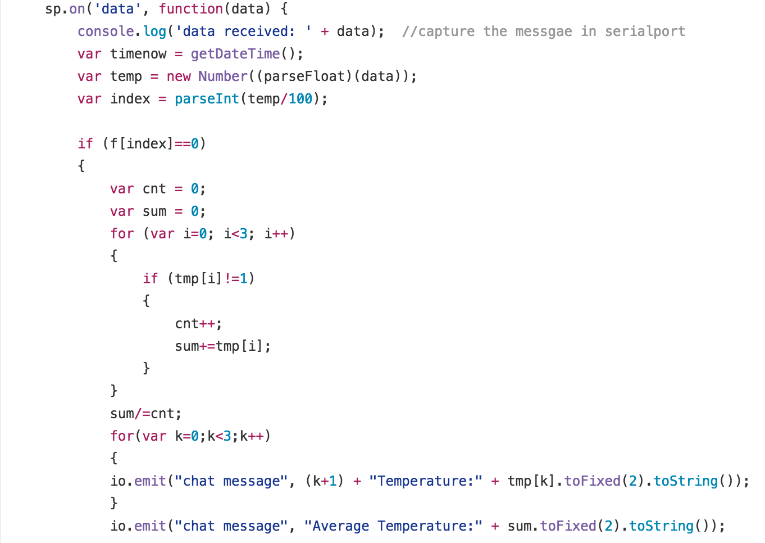
Improvement
Improved the circuit design problem in Challenge 1 to solve the sensor problem
Optimized the Arduino code to take router broken into consideration

Slide 11
Future improvement
Better layout design
Make the chart more interactive

Slide 12
Thank you !

